Slide 1
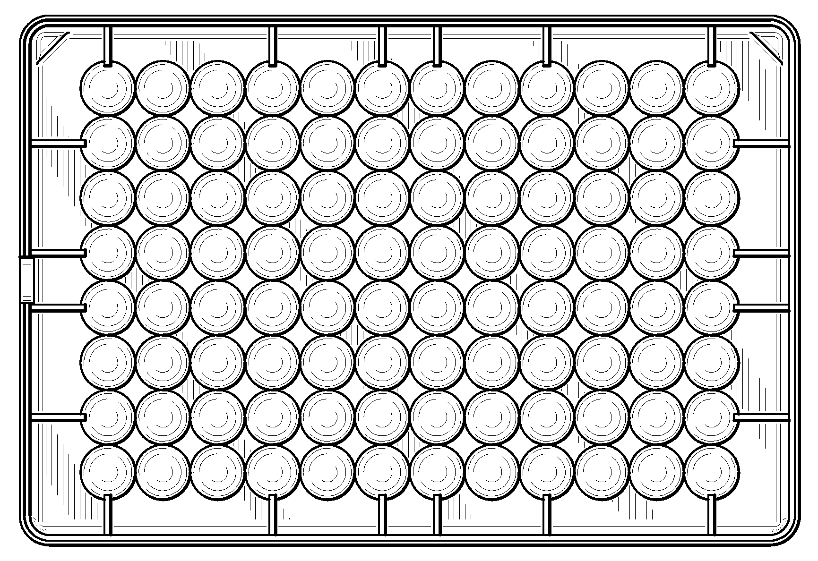

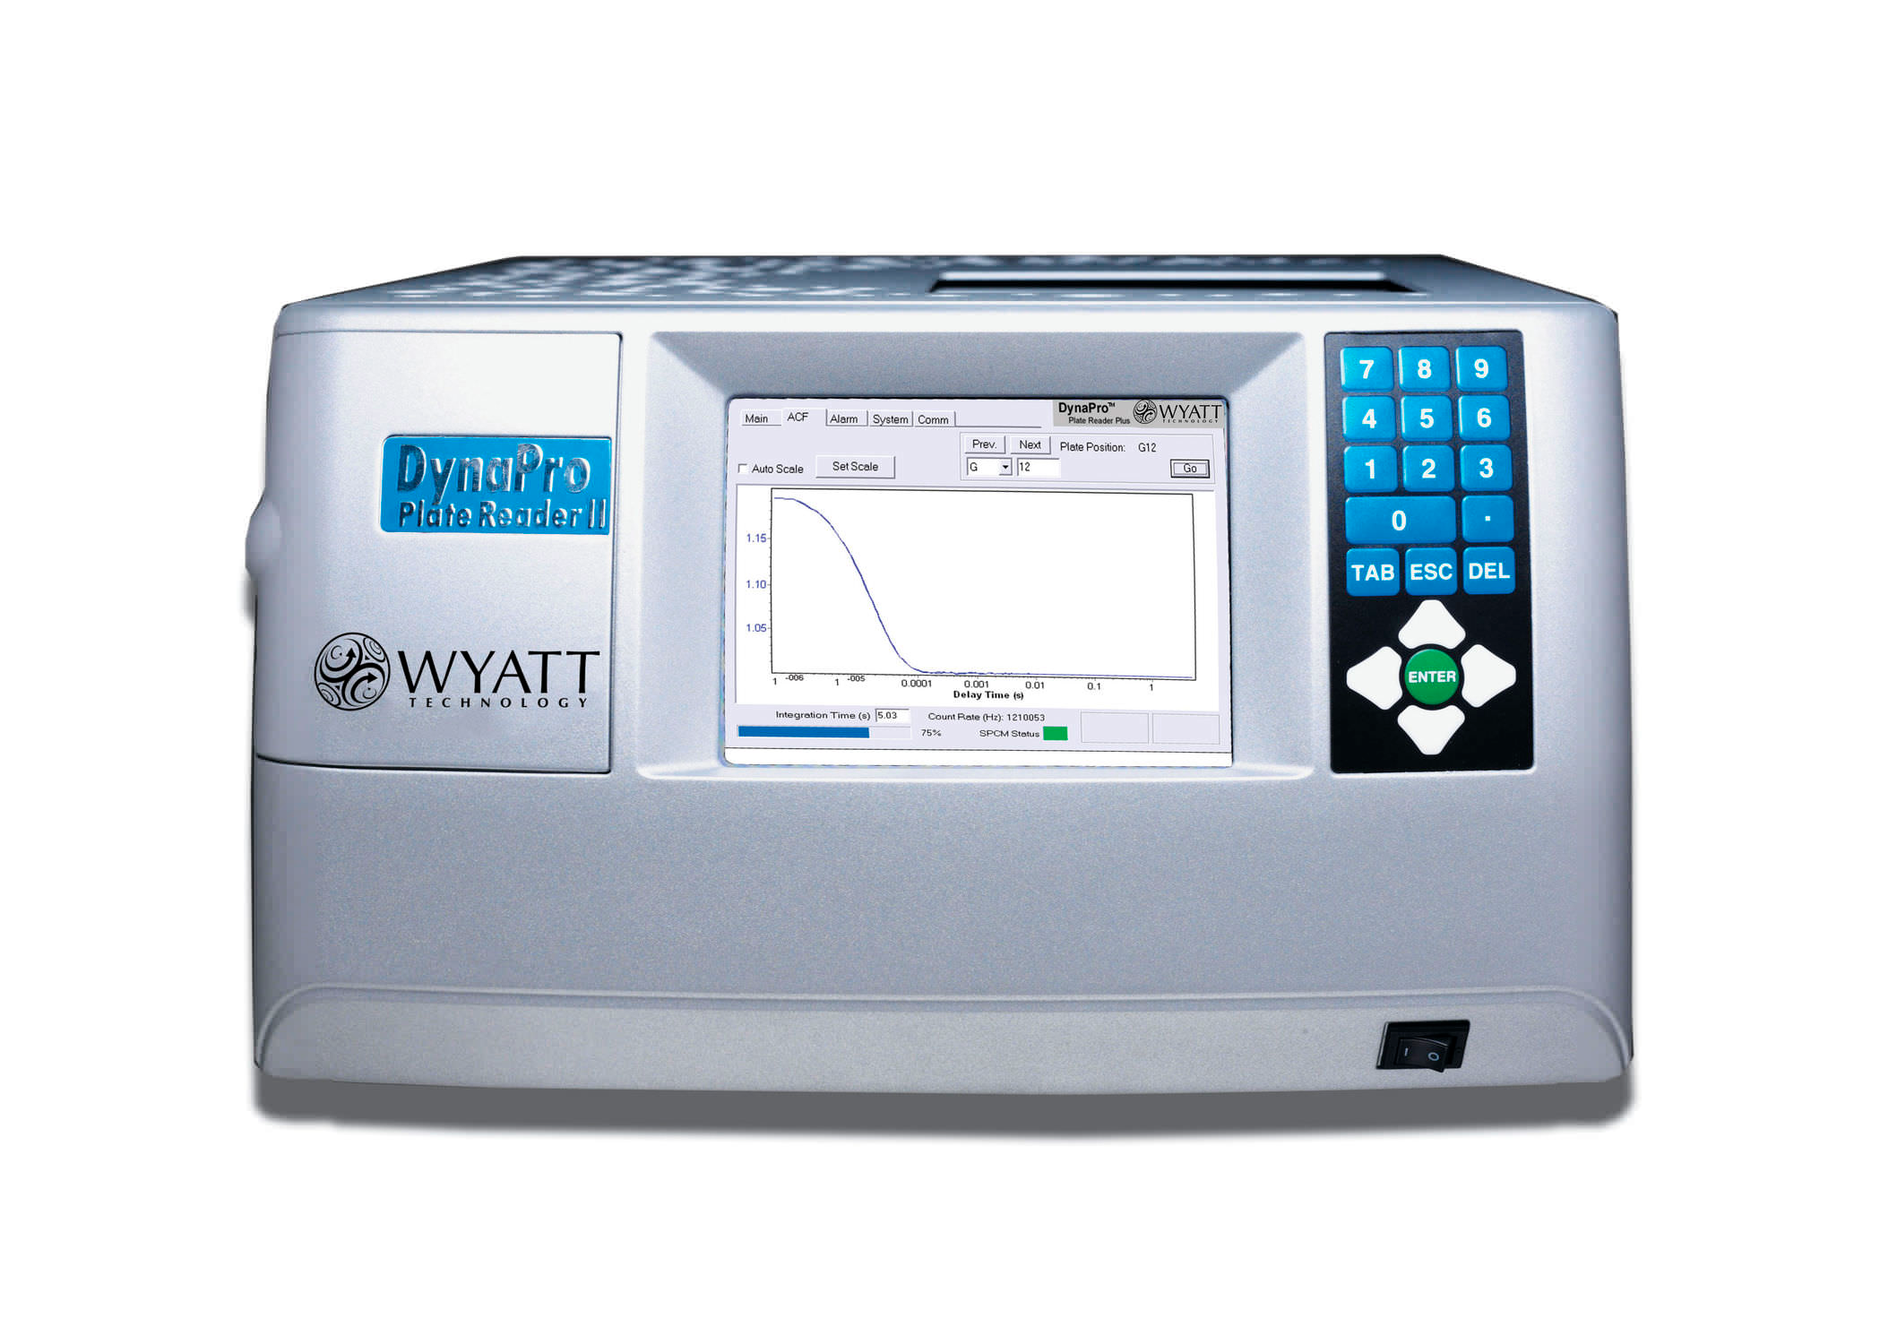
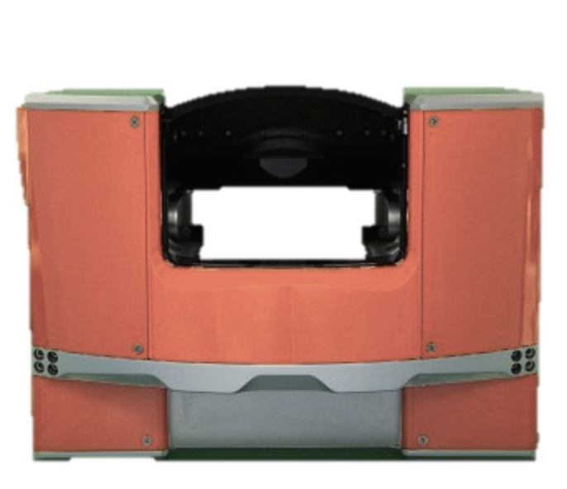
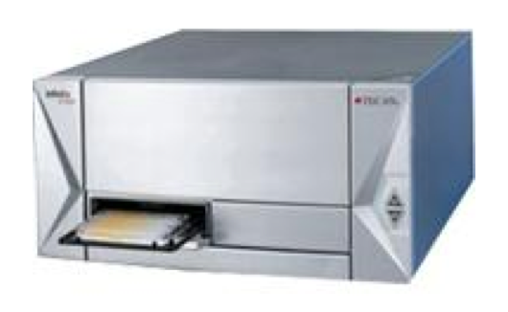
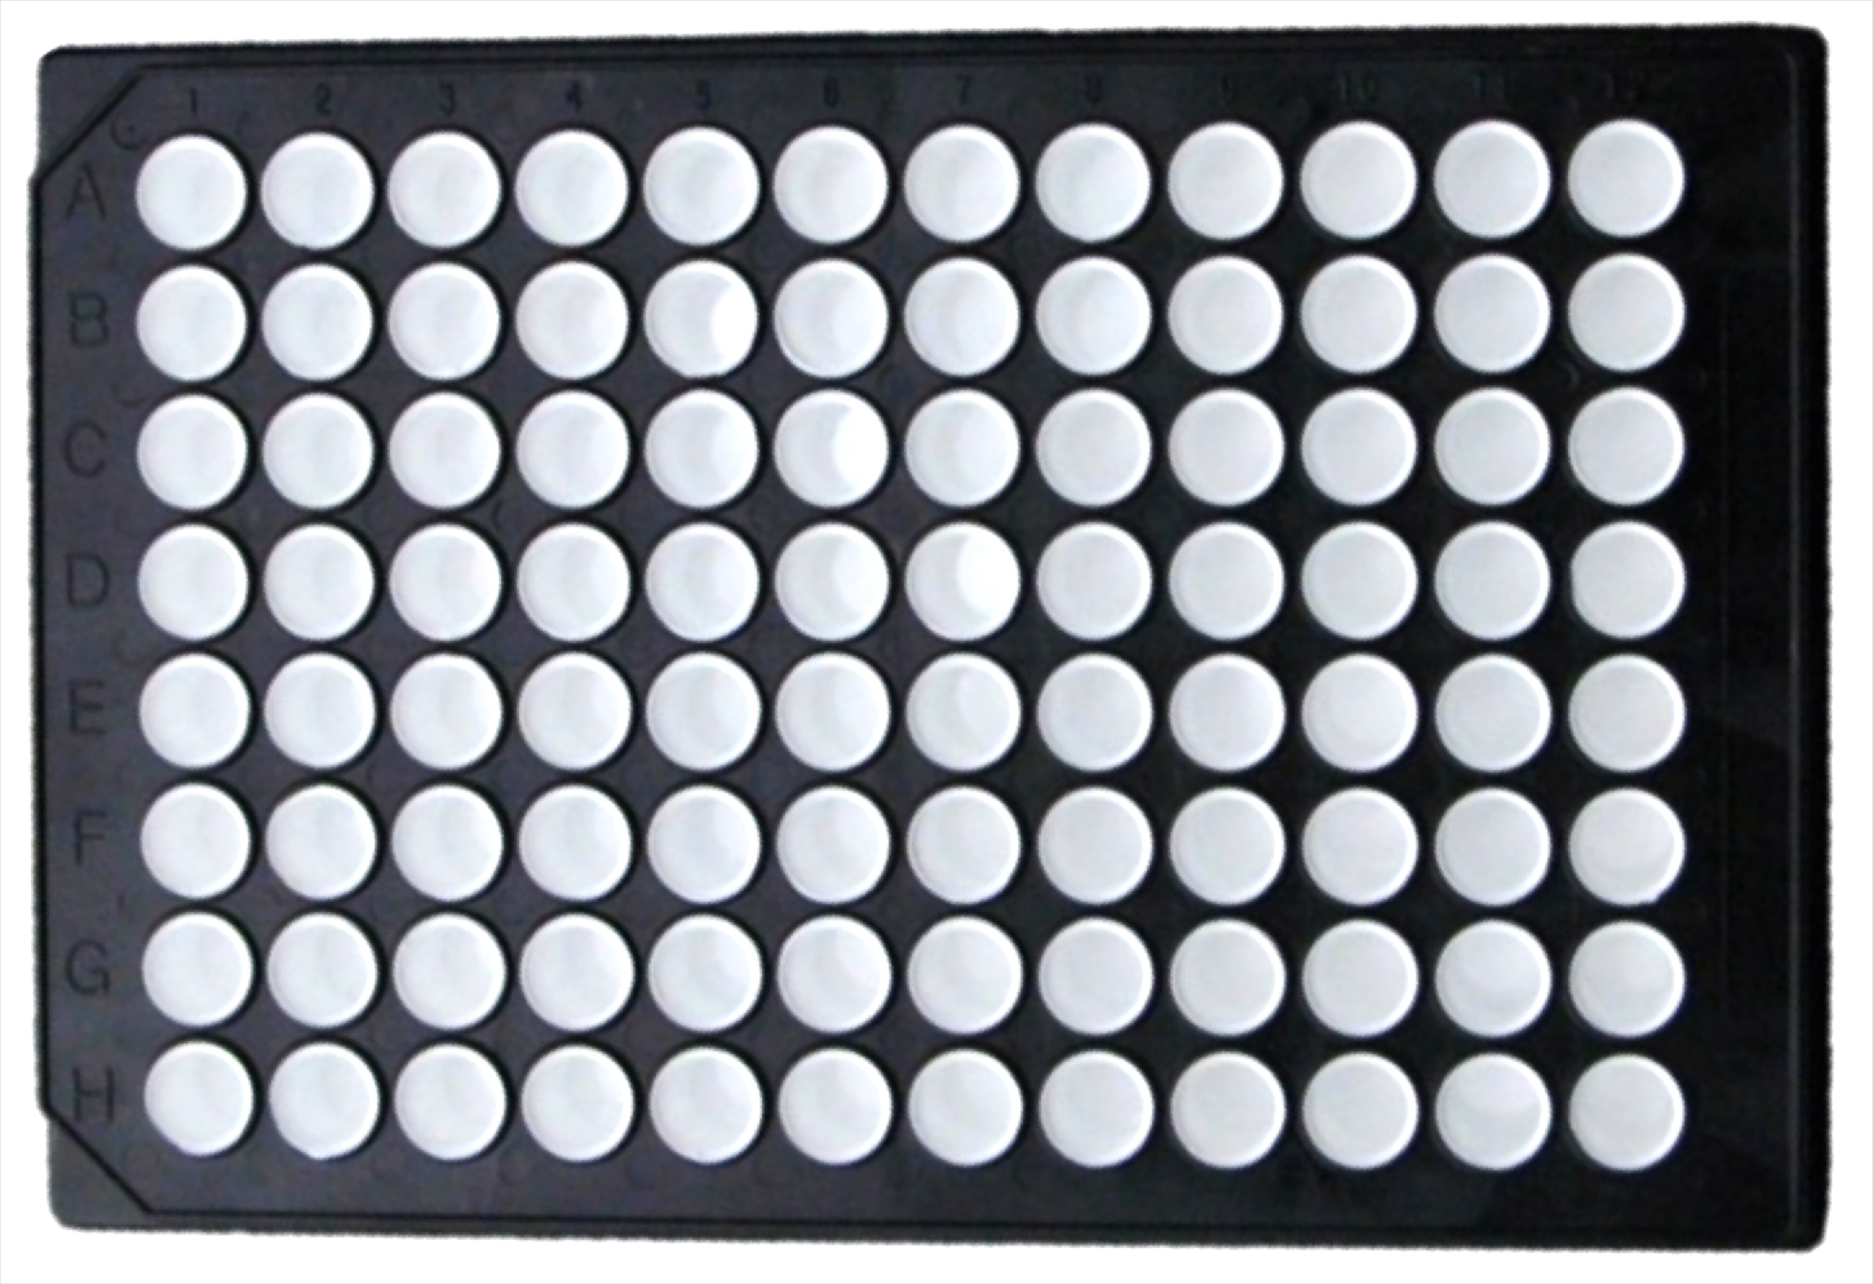
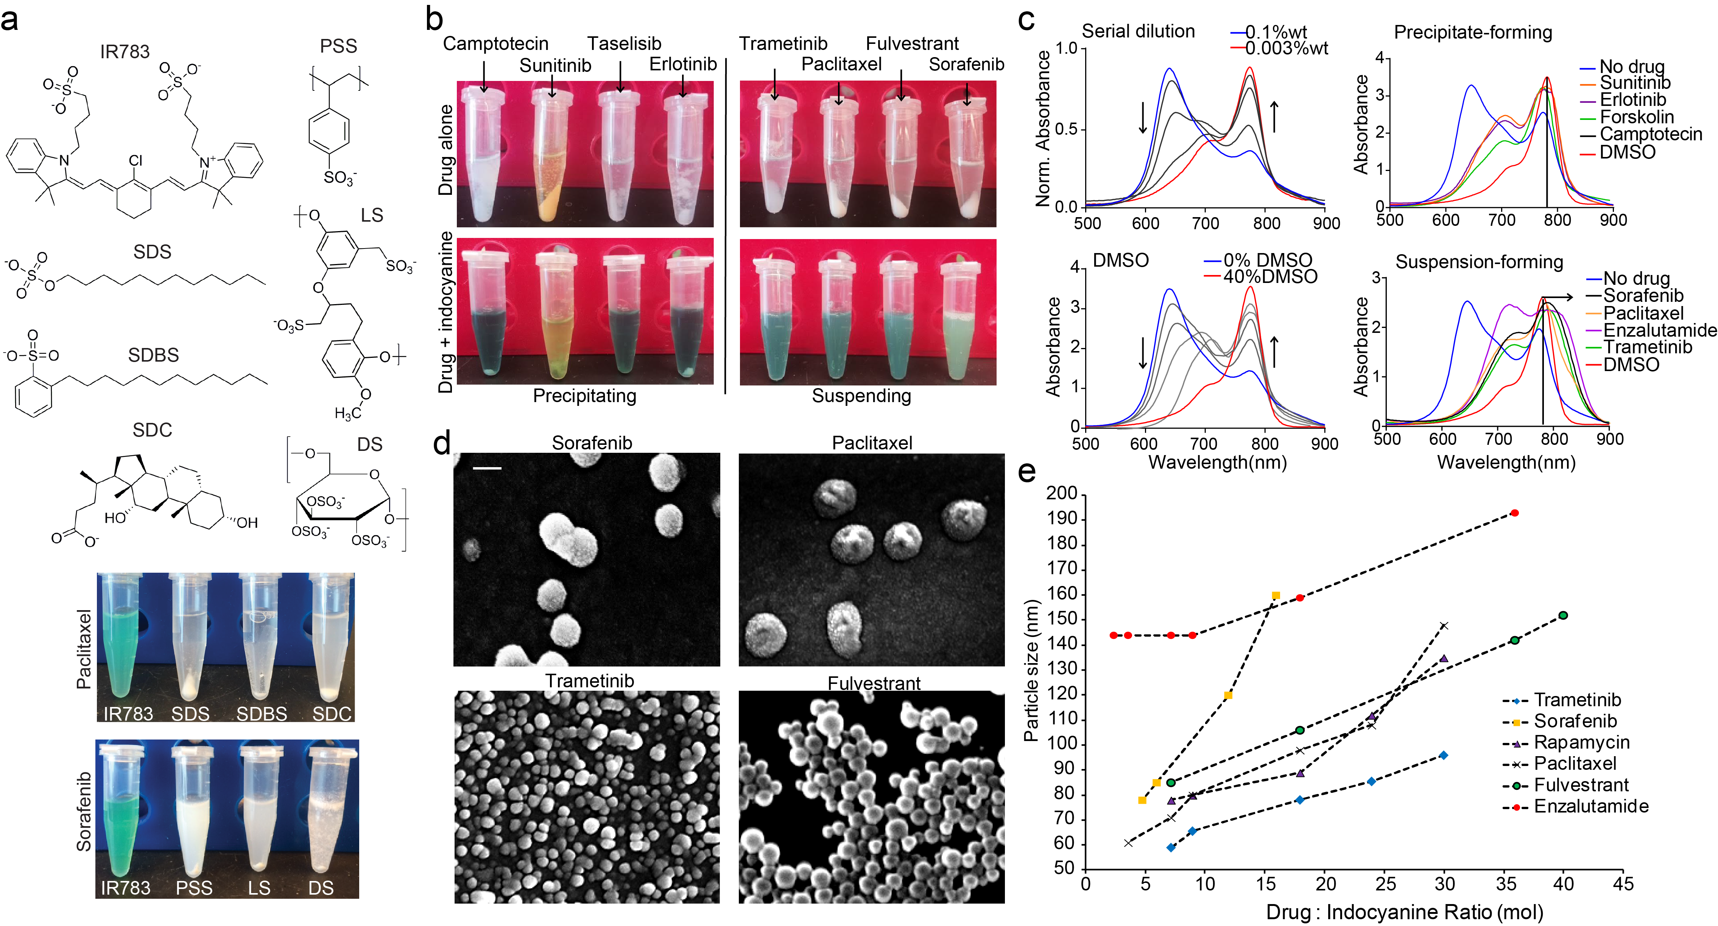
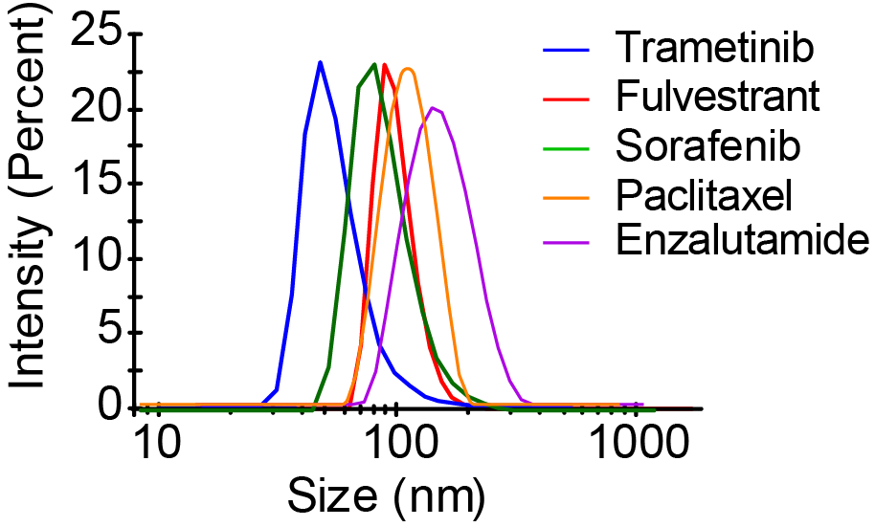
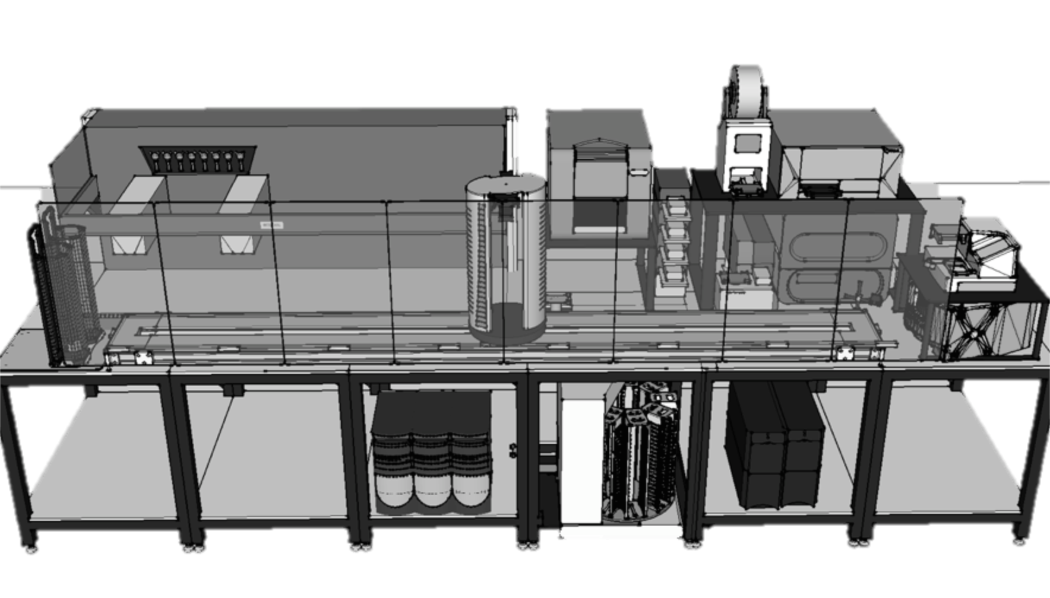

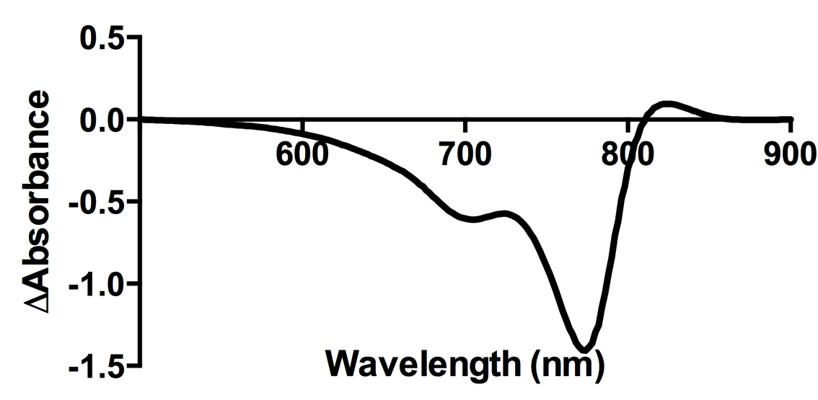
Kinase Inhibitor Library
Microplate Centrifuge
Bionex HiG4
Spectrophotometer
TECAN Infinite M1000
DLS Instrument
Wyatt Dynapro Plate Reader
Mix and
centrifuge
Excipient
(IR783)
Clear bottom assay plate
Liquid Handler TECAN EVO
Figure 2. Automated workflow for screening kinase inhibitors for nanoparticle formation. We will use our automated biophysical wetlab. (Layout on lower left. See Equipment – Chodera Lab.) Kinase inhibitors from microplate format library will be mixed with excipient IR-783 using TECAN Freedom EVO liquid handling system and will be mixed using on-deck Inheco plate shakers. Assay plate will be centrifuged in Bionex HiG4 robotic centrifuge. Absorbance spectra will be measured using TECAN Infinite M1000. Change in excipient absorbance values around 850 nm indicates formation of nanoparticles. The same assay plate will also be read with DLS to determine particle size. This high-throughput automated experimental setup will allow us to screen multitude of drugs, excipient and buffer conditions efficiently.

